Slide 1
TEAM 4 P_294 Manufacturing Analytics
Team Members Harshith N, Priti Jagtap, Prakruti Kunjal Thakor, Bhavin Bijal Parmar, Snehal Satish Pujari, Mayank Chikane , R. Jayasowmya

Slide 2
Adventure Works Cycles Company Details
A large multinational manufacturing company that sells metal and composite bicycles.
Base operation is in Bothell, Washington with 290 employees.
Distributes products to North America, Europe and Asian commercial markets.
In 2000s, a small manufacturing plant was established in Mexico, to manufacture critical subcomponents.
But the final assembly of manufactured subcomponents happens at base operation location i.e. Bothell, Washington.
In one year’s time the manufacturing plant in Mexico became the sole manufacturer and distributor of touring bicycle products.

Slide 3
Business Problem
Broaden market share
How? By targeting sales to best customers
Extend product availability through an external website
Reduce COST OF SALES through lowered PRODUCTION COSTS

Slide 4
Data Model

Slide 5
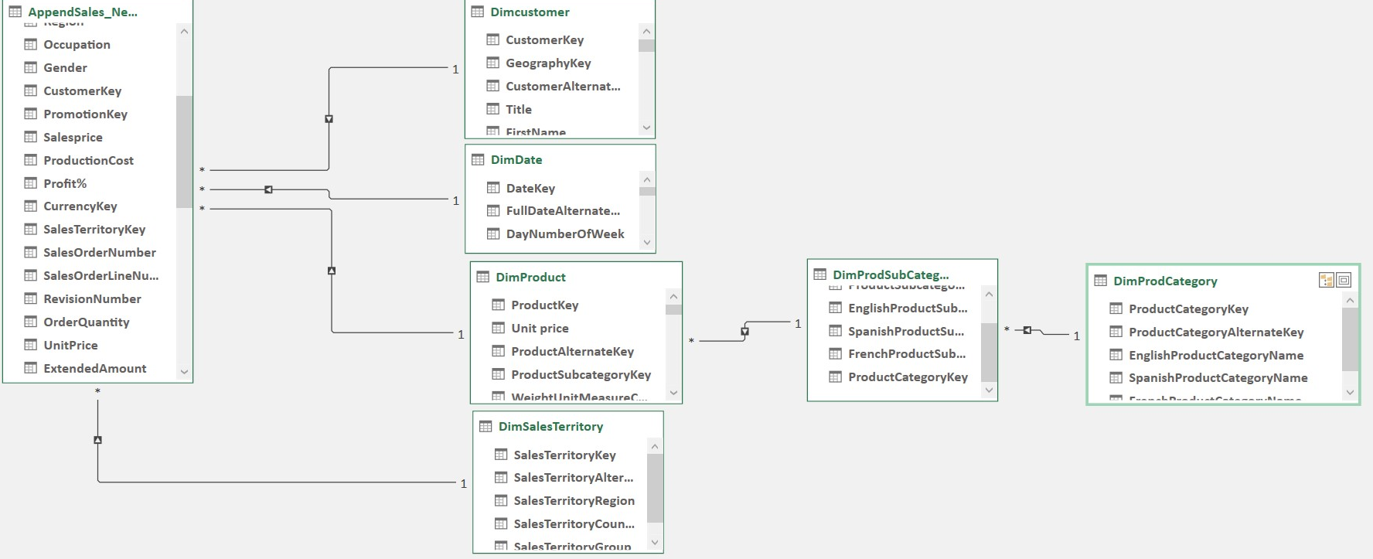
Excel Data Model

Slide 6
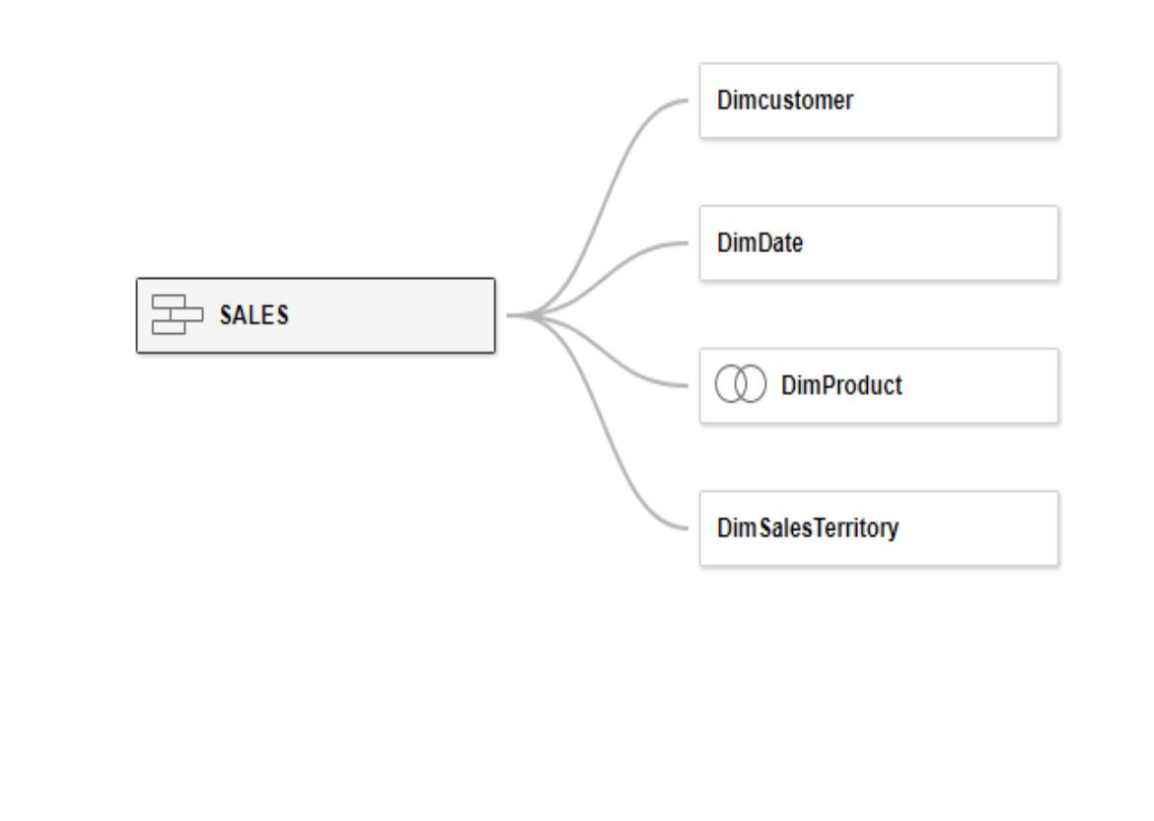
Tableau Data Model

Slide 7
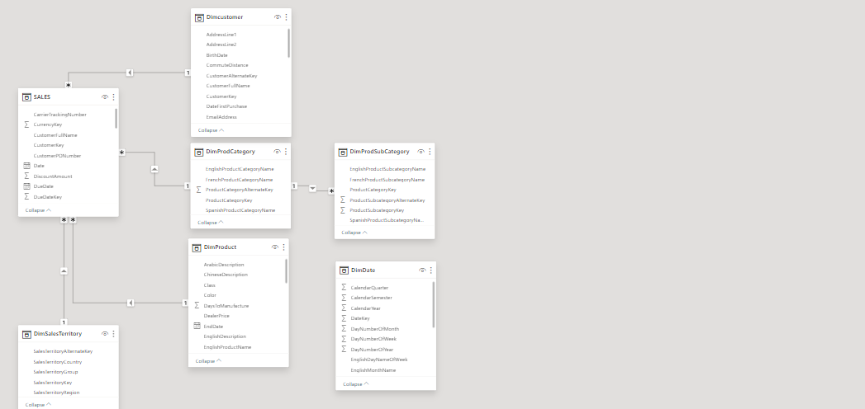
Power Bi Data Model

Slide 8
Challenges Faced
Q4 exhibits high sales and profit with respect all years where as Q1,Q2 and Q3 exhibits lower sales performance.
Manufacturing plant being in Mexico might attract higher production cost, labour cost, since North America exhibits( GDP) higher standard of living as compared to other continents.
Sales of bicycles other than touring bicycles is low.
E-marketing through websites or any social media.

Slide 9
Dashboards

Slide 10
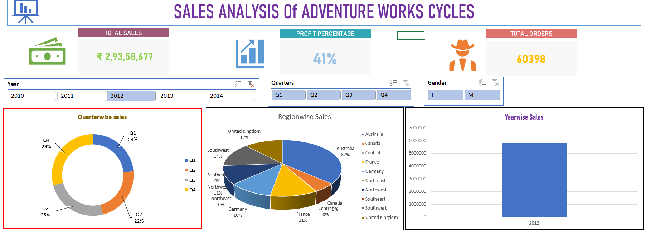
Excel Dashboard

Slide 11
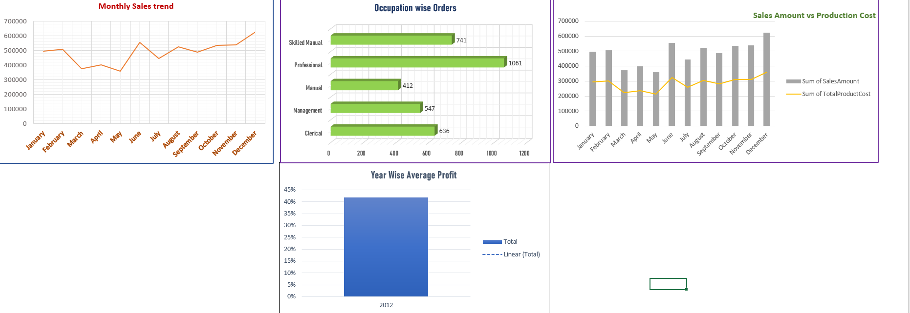
Continue…

Slide 12
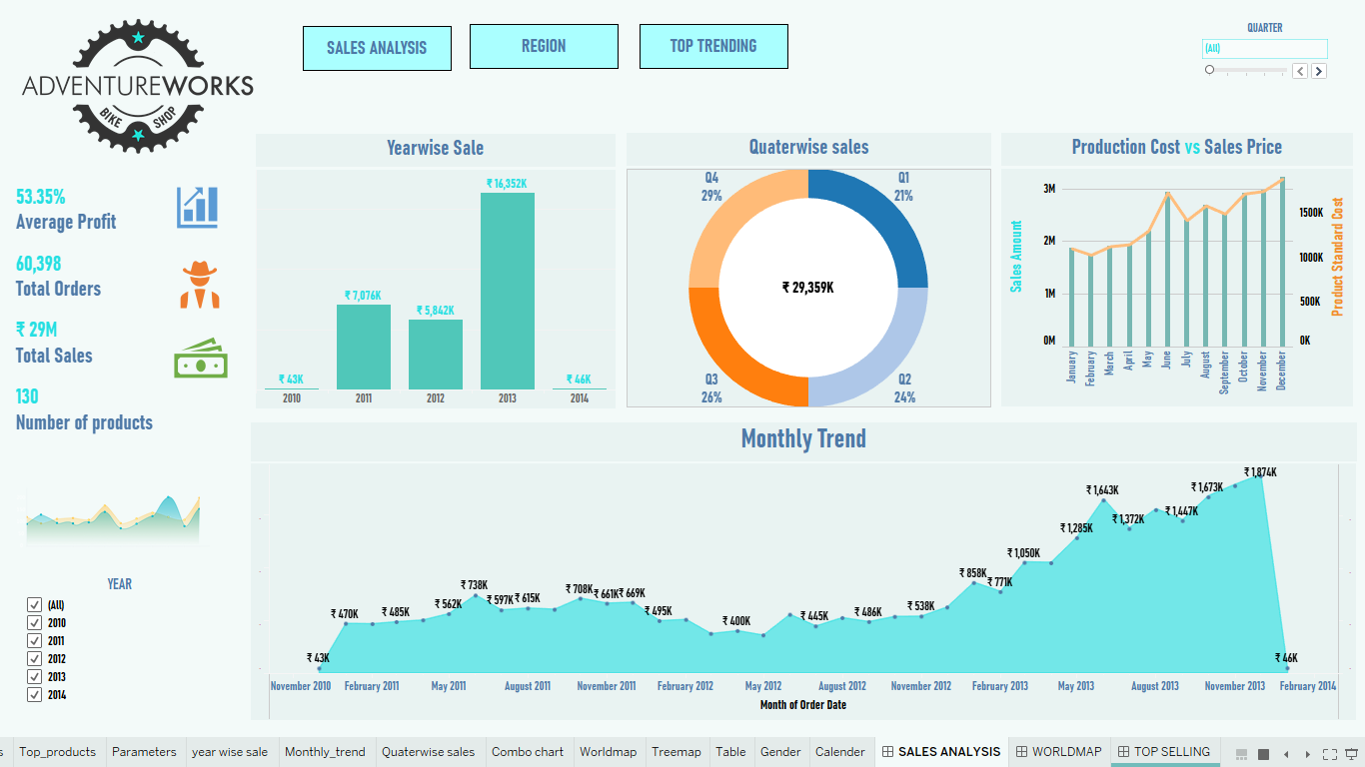
Tableau Dashboard

Slide 13
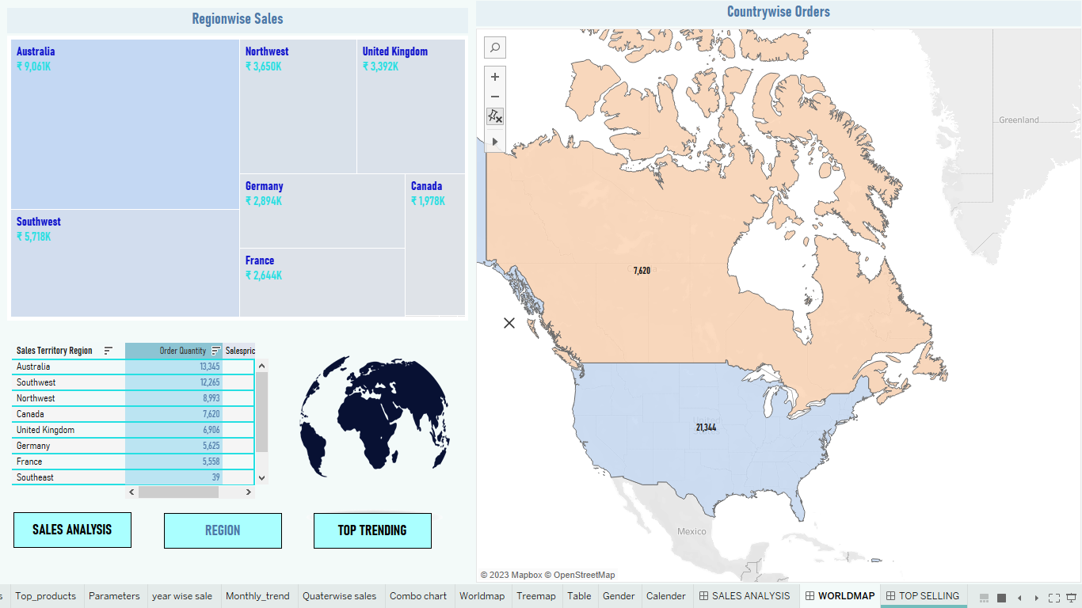
Continue…

Slide 14
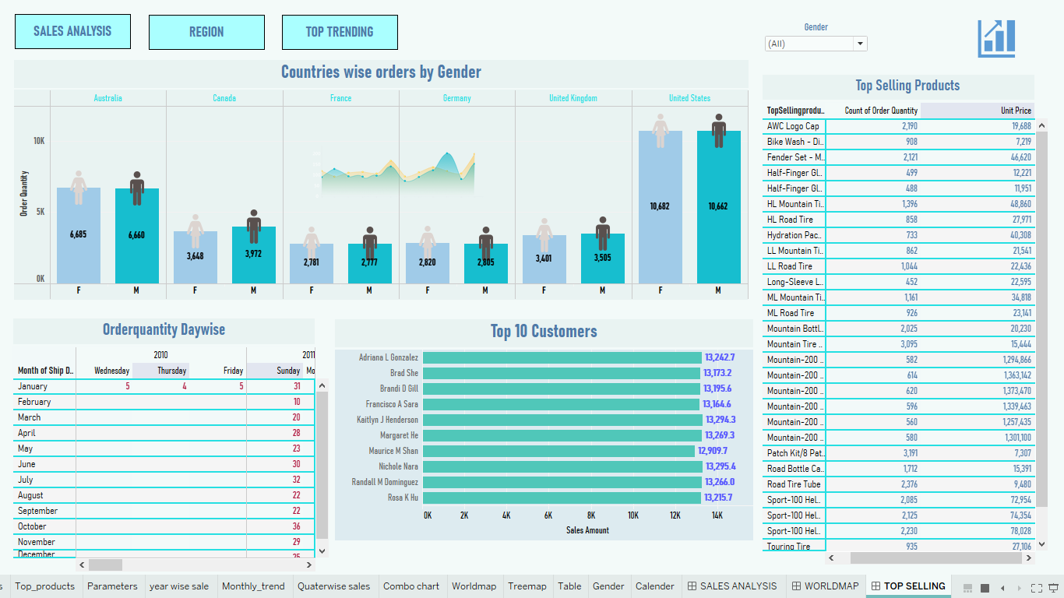
Continue…

Slide 15
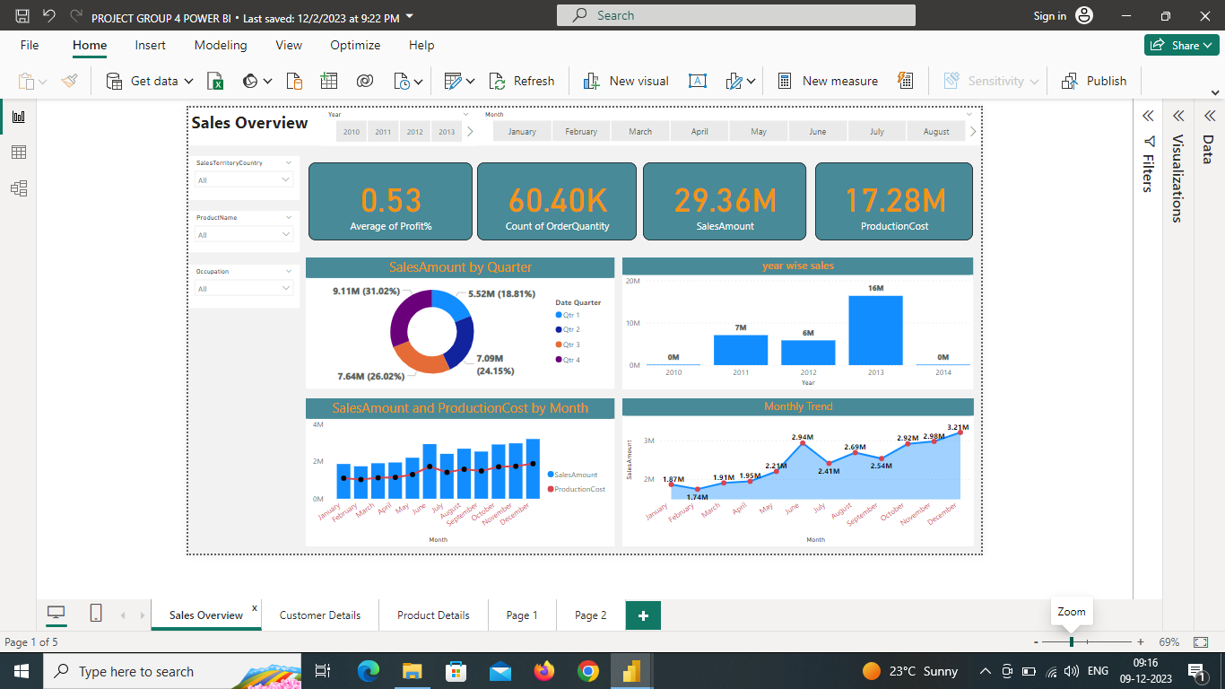
Power Bi Dashboard

Slide 16
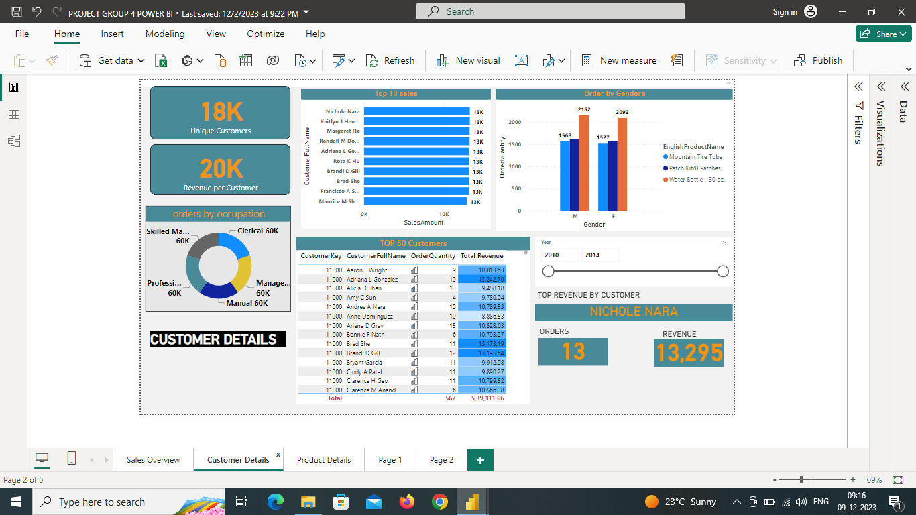
Continue…

Slide 17
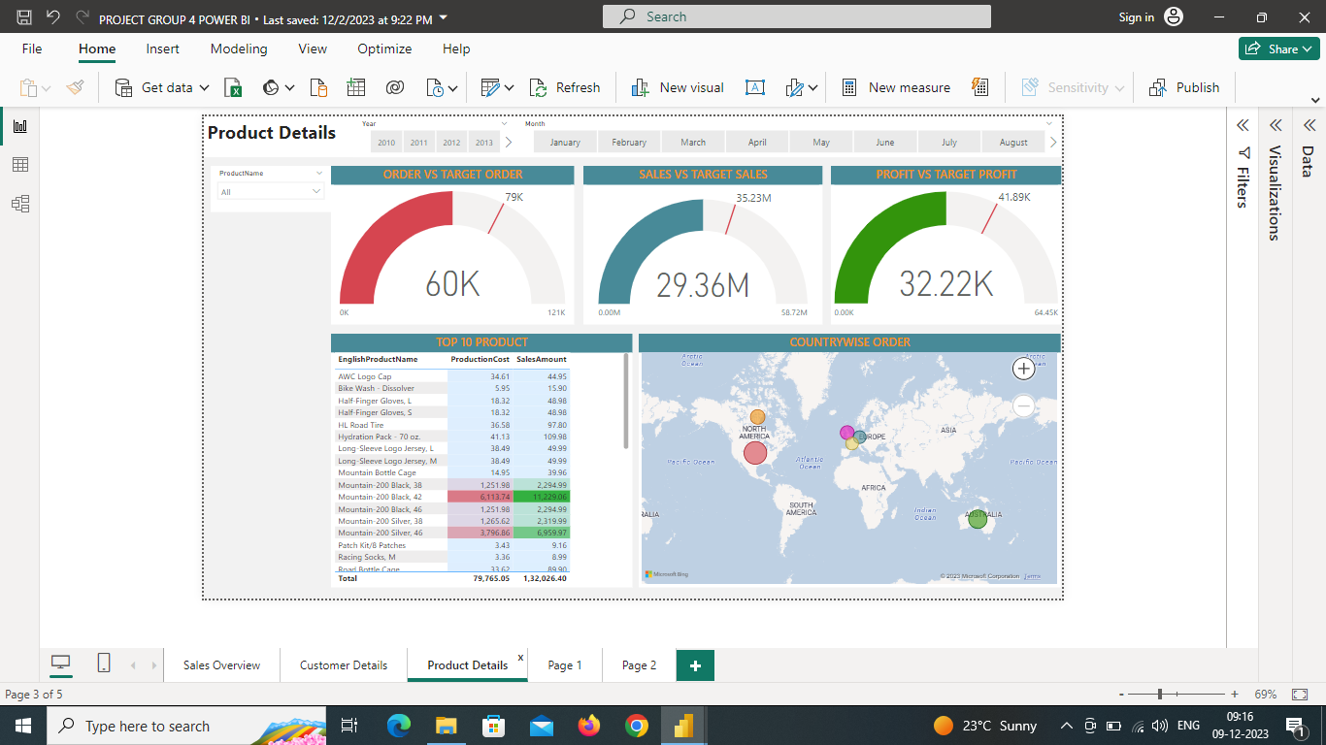
Continue…

Slide 18
Strategies to improve sales
Top 10 customers( Power Bi dashboard)- Offer exclusive discounts, early access or special perks or family coupons to buy more cycles
Spend 2% of profit in E-marketing business.
Plan to open manufacturing plants in Australia( as it as exhibited high sales) and in Africa, Europe or South America as they exhibit lower GDP compared to North America(Bothell, Washington present manufacturing plant) so that production cost and labour cost goes down.
Encourage unique customers to become regular customers by offering benefit plans.
Implement personalised marketing campaigns based on customer preferences and behaviours.

Slide 19
THANK YOU

